Slide 1


Spatial Ecology and Macroecology
Petr Keil
Notes:
Hi, my name is Petr Keil and this is my project Biodiversity dynamics across a continuum of space, time, and their scales.

Slide 2
Course contents, conditions
Zápočet:
Participation on practical classes (3 absences max)
Finishing and presenting a mini project
Exam:
An informal 1:1 dialogue (ca 30 min)
Content of the lectures + content of the “Lectures” folder in the GitHub repo (.pdf papers) + questions related to practical classes
Best literature:
No book that has it all; most literature in English
Lomolino et al. – Biogeography
Brown – Macroecology
Mittlebach & McGill – Community Ecology
Begon – Základy ekologie (in Czech), i.e. chapter 10
Notes:
These are also topics that we study in my research group.

Slide 3

Petr Keil
I come from the outside
I have been doing macroecology for 17 years now
MSc in zoology (entomology) and ecology at BF JČU (České Budějovice)
2006-2010 - PhD in macroecology at PřF UK (Prof. David Storch)
2011-2014 - 3 years postdoc at Yale University, USA (Prof. Walter Jetz)
2015-2020 - 5 years postdoc at iDiv in Leipzig, Germany (Prof. Jonathan Chase)
At CZU since fall 2020
Independently funded since January 2023
This course is tightly linked to my research
The course will develop on the go
Notes:
These are also topics that we study in my research group.

Slide 4
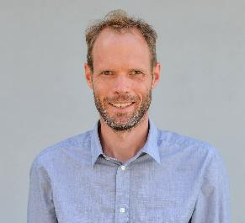
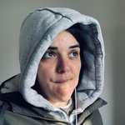

Contacts and links
The teaching team for 2022/2023:
Petr Keil (guarantor, keil@fzp.czu.cz)
Florencia Grattarola (postdoc, grattarola@fzp.czu.cz)
Francois Leroy (PhD student, leroy@fzp.czu.cz)
MOBI lab
Our research: https://petrkeil.github.io/
Notes:
These are also topics that we study in my research group.

Slide 5
Some related fields
Spatial ecology
Macroecology
Geography
Biogeography
Biodiversity science
Ecosystem ecology
Conservation biology
Geostatistics, spatial modelling
Remote sensing
Evolutionary biology
Paleontology
Geographic Information Systems
Species Distribution Modelling
Spatial scale, grain, resolution, extent
Global, continental, regional, local
Notes:
These are also topics that we study in my research group.

Slide 6
Brief history of macroecology and biogeography
The chronologically ordered list of old farts

Slide 7
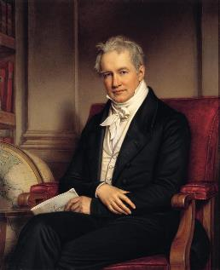
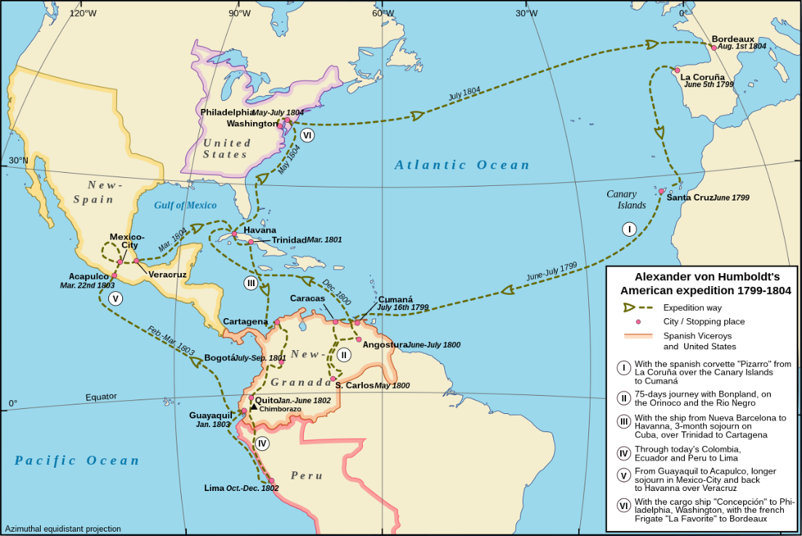
Alexander von Humboldt
1800
1850
1900
1950
2000
Notes:
In this panel we can probably all agree that biodiversity is one of the most valuable natural resources.
But things like climate change or habitat loss are a threat to biodiversity, to the extent that we hear about biodiversity crisis, or sixth mass extinction
For example, about 1% of vertebrate species have gone extinct because of humans

Slide 8
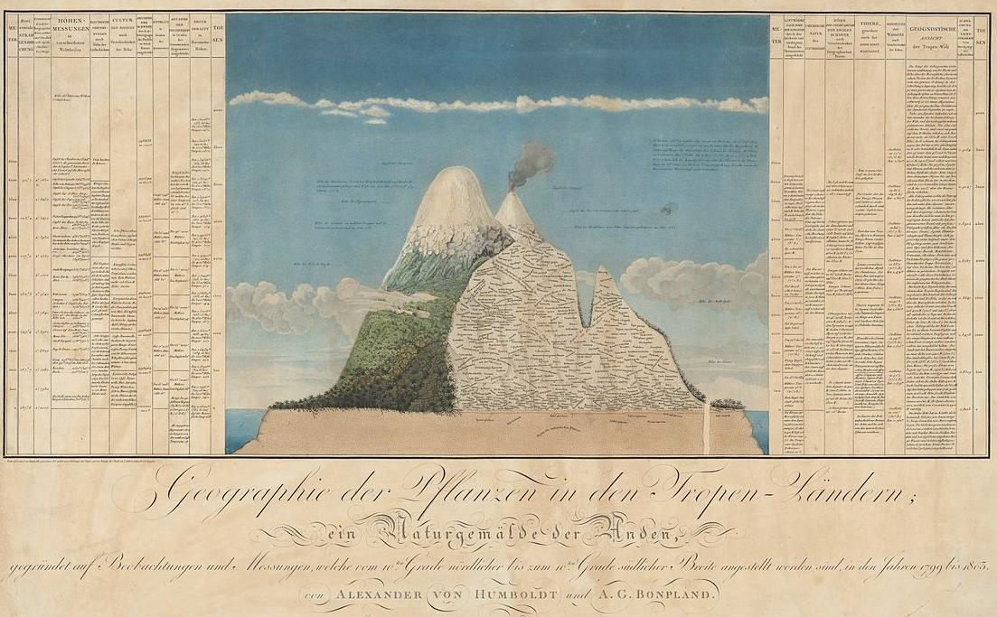
Alexander von Humboldt
1800
1850
1900
1950
2000
Naturgemälde, from The Geography of Plants, 1807
Notes:
In this panel we can probably all agree that biodiversity is one of the most valuable natural resources.
But things like climate change or habitat loss are a threat to biodiversity, to the extent that we hear about biodiversity crisis, or sixth mass extinction
For example, about 1% of vertebrate species have gone extinct because of humans

Slide 9
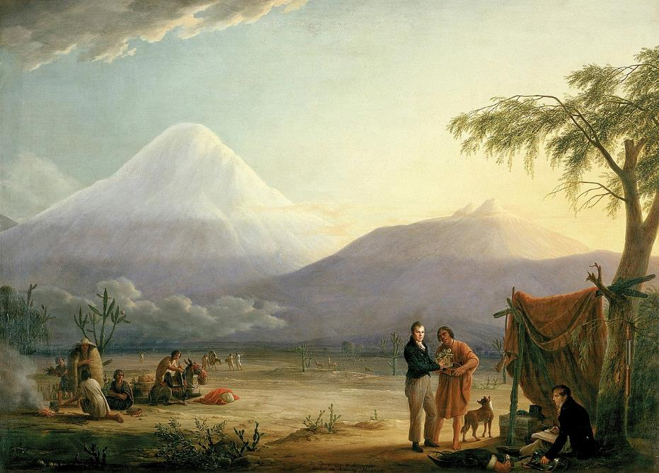
Alexander von Humboldt
1800
1850
1900
1950
2000
Chimborazo volcano, Friedrich Georg Weitsch (1810)
Notes:
In this panel we can probably all agree that biodiversity is one of the most valuable natural resources.
But things like climate change or habitat loss are a threat to biodiversity, to the extent that we hear about biodiversity crisis, or sixth mass extinction
For example, about 1% of vertebrate species have gone extinct because of humans

Slide 10
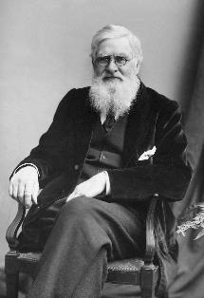
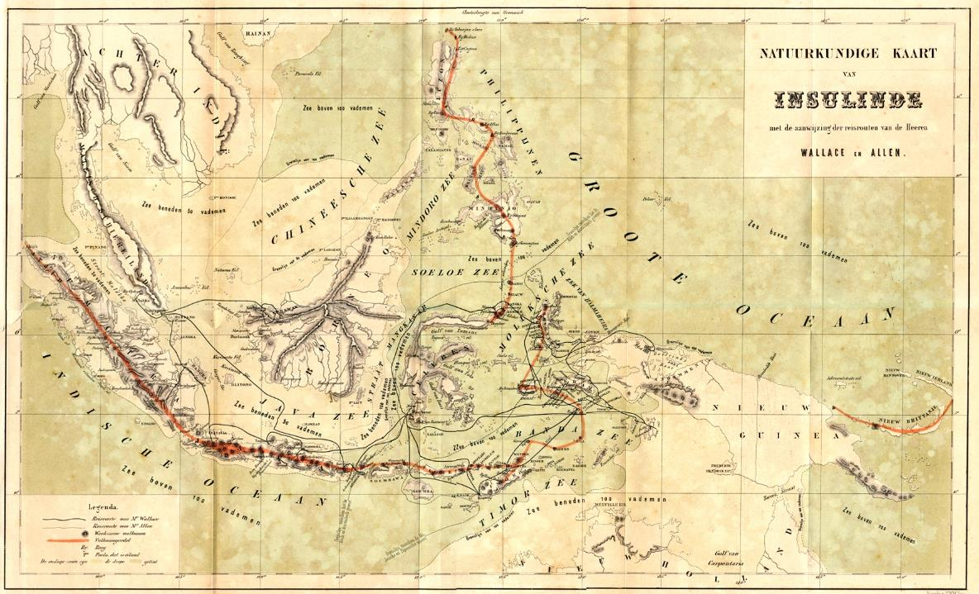
Alfred Russell Wallace – biogeographical regions
1800
1850
1900
1950
2000
Wallace (1876) The Geographical Distribution of Animals
Notes:
In this panel we can probably all agree that biodiversity is one of the most valuable natural resources.
But things like climate change or habitat loss are a threat to biodiversity, to the extent that we hear about biodiversity crisis, or sixth mass extinction
For example, about 1% of vertebrate species have gone extinct because of humans

Slide 11
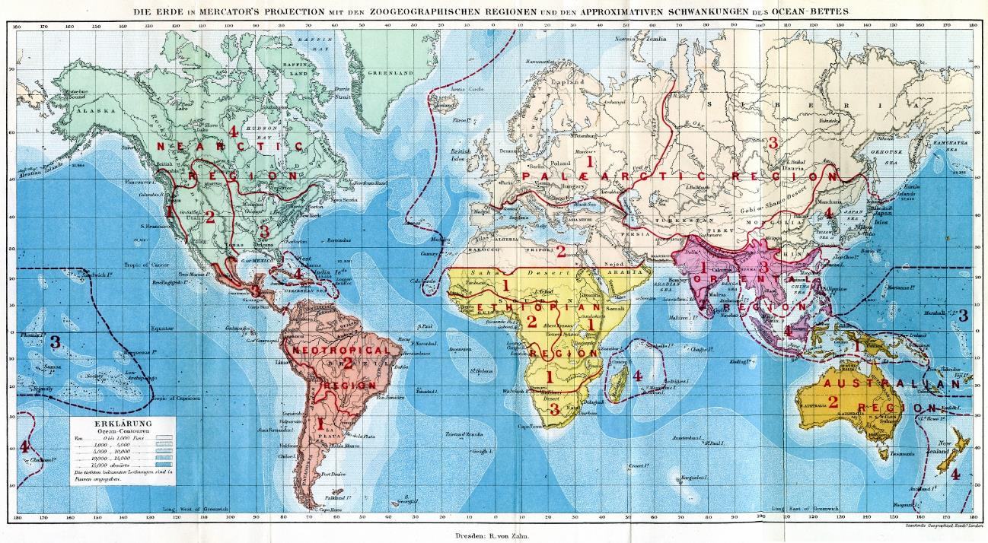
Alfred Russell Wallace – biogeographical regions
1800
1850
1900
1950
2000
Wallace (1876) The Geographical Distribution of Animals
Notes:
In this panel we can probably all agree that biodiversity is one of the most valuable natural resources.
But things like climate change or habitat loss are a threat to biodiversity, to the extent that we hear about biodiversity crisis, or sixth mass extinction
For example, about 1% of vertebrate species have gone extinct because of humans

Slide 12
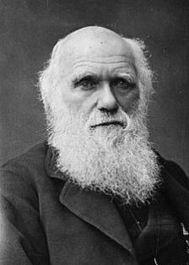
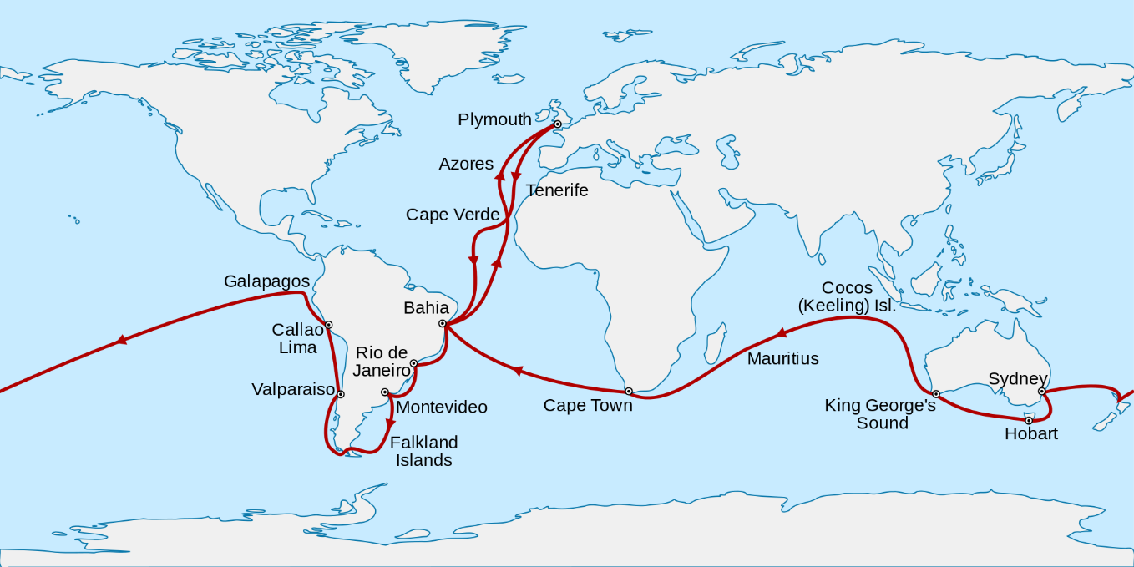
Charles Darwin – the idea of universal laws (the Entangled Bank)
1800
1850
1900
1950
2000
Darwin (1859) On the Origin of Species.
Voyage of the Beagle, 1831-1836
Notes:
In this panel we can probably all agree that biodiversity is one of the most valuable natural resources.
But things like climate change or habitat loss are a threat to biodiversity, to the extent that we hear about biodiversity crisis, or sixth mass extinction
For example, about 1% of vertebrate species have gone extinct because of humans

Slide 13
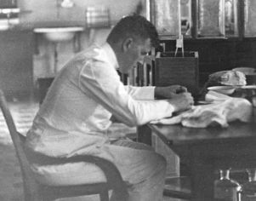
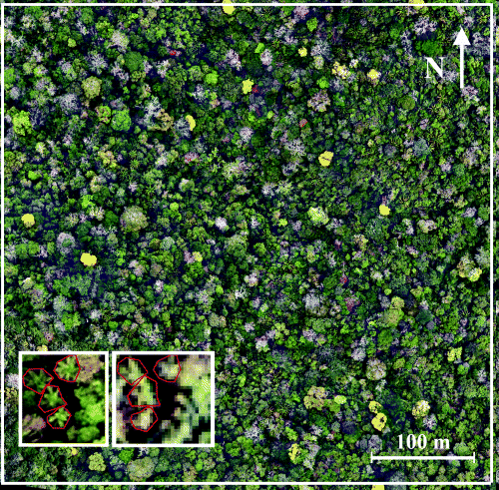
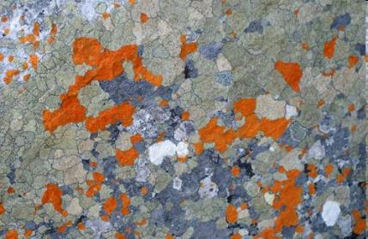
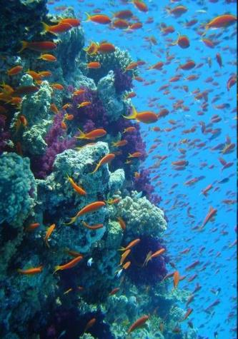
Olof Arrhenius –the larger the area the more species
1800
1850
1900
1950
2000
Arrhenius (1921) Species and area. Journal of Ecology, 9: 95-99.
Notes:
In this panel we can probably all agree that biodiversity is one of the most valuable natural resources.
But things like climate change or habitat loss are a threat to biodiversity, to the extent that we hear about biodiversity crisis, or sixth mass extinction
For example, about 1% of vertebrate species have gone extinct because of humans

Slide 14
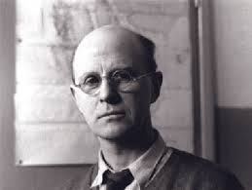
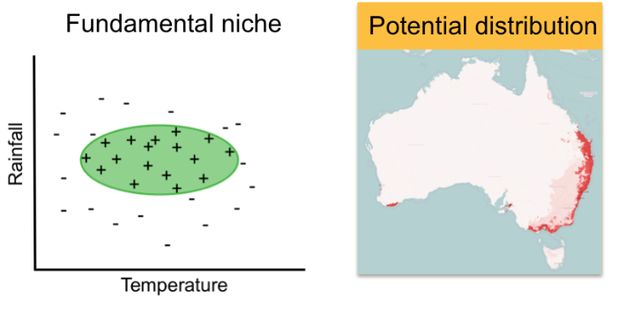
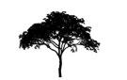
Charles S. Elton – ecological niche
1800
1850
1900
1950
2000
Elton (1927) Animal Ecology
Notes:
In this panel we can probably all agree that biodiversity is one of the most valuable natural resources.
But things like climate change or habitat loss are a threat to biodiversity, to the extent that we hear about biodiversity crisis, or sixth mass extinction
For example, about 1% of vertebrate species have gone extinct because of humans

Slide 15
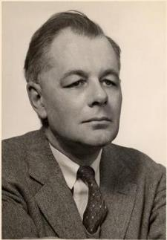
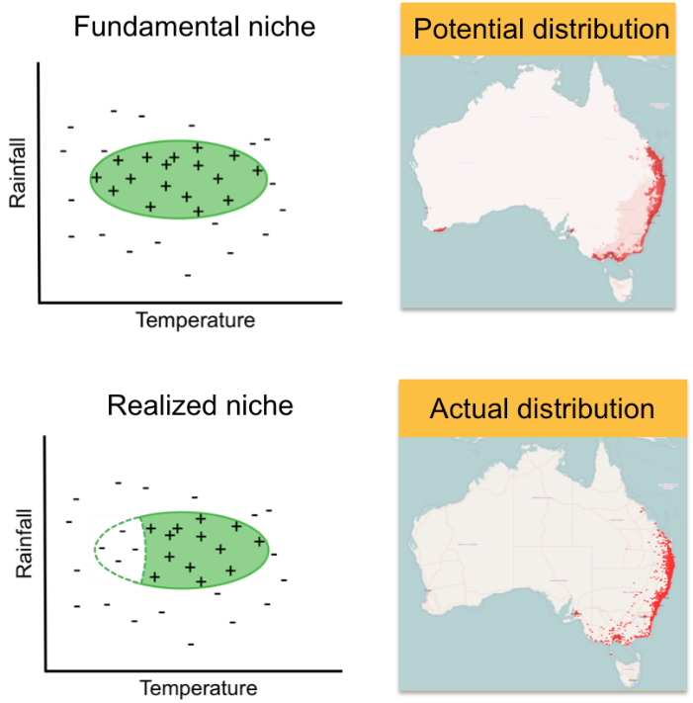
G. Evelyn Hutchinson – fundamental vs realized niche and the problem of rarity
1800
1850
1900
1950
2000
Hutchinson (1957) Concluding remarks, Cold Spring Harbor Quant Biol 22: 415-27.
Notes:
In this panel we can probably all agree that biodiversity is one of the most valuable natural resources.
But things like climate change or habitat loss are a threat to biodiversity, to the extent that we hear about biodiversity crisis, or sixth mass extinction
For example, about 1% of vertebrate species have gone extinct because of humans

Slide 16
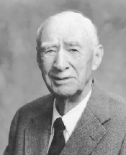
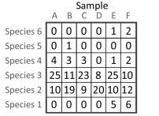
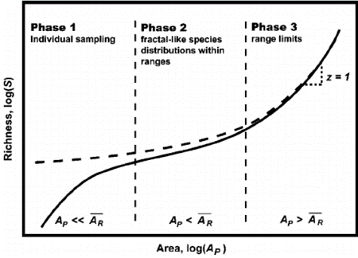
Frank Preston – the canonical distribution of rarity
1800
1850
1900
1950
2000
Site
Preston laboratories, Pennsylvania, where he did research on glass.
Storch (2016) JVS
Preston (1948) The Commonness, And Rarity, of Species. Ecology.
Notes:
In this panel we can probably all agree that biodiversity is one of the most valuable natural resources.
But things like climate change or habitat loss are a threat to biodiversity, to the extent that we hear about biodiversity crisis, or sixth mass extinction
For example, about 1% of vertebrate species have gone extinct because of humans

Slide 17
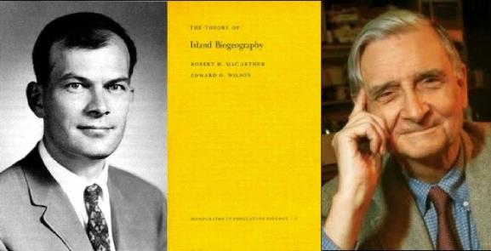
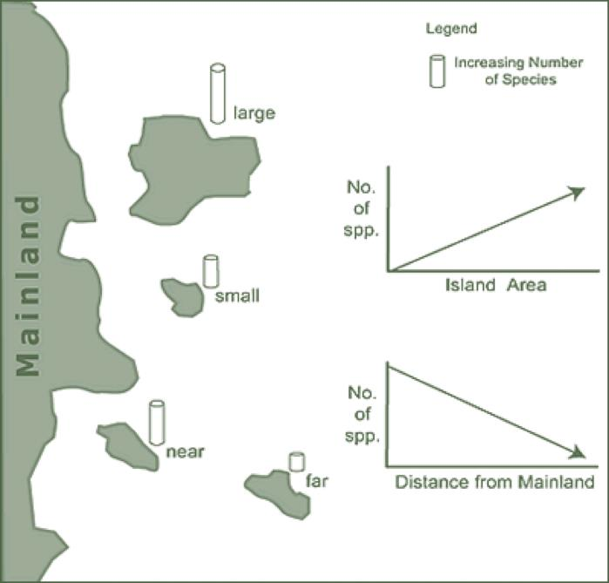
Robert MacArthur & Edward O. Wilson – theory of island biogeography
1800
1850
1900
1950
2000
Illustration: Corey J. A. Bradshaw
Macarthur & Wilson (1967) The Theory of Island Biogeography. Princeton.
Notes:
In this panel we can probably all agree that biodiversity is one of the most valuable natural resources.
But things like climate change or habitat loss are a threat to biodiversity, to the extent that we hear about biodiversity crisis, or sixth mass extinction
For example, about 1% of vertebrate species have gone extinct because of humans

Slide 18
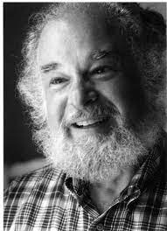
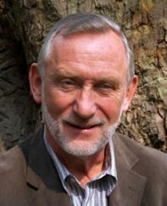
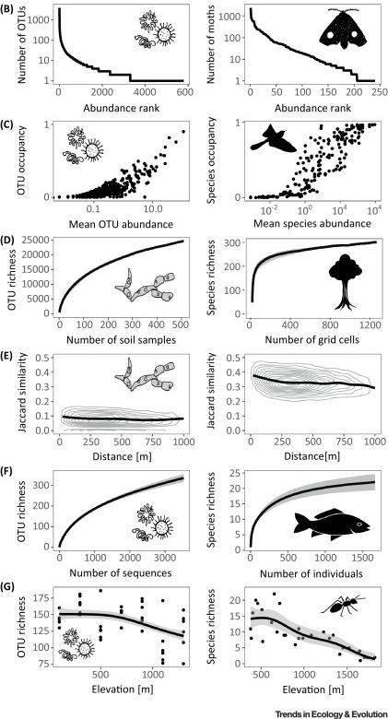
James H. Brown, Michael Rosenzweig, John Lawton – macroecology and ecological patterns
1800
1850
1900
1950
2000
Is ecology a mess or are there universal laws an patterns, like in physics?
Brown (1995) Macroecology.
Rosenzweig (1995) Species diversity in space and time
Notes:
In this panel we can probably all agree that biodiversity is one of the most valuable natural resources.
But things like climate change or habitat loss are a threat to biodiversity, to the extent that we hear about biodiversity crisis, or sixth mass extinction
For example, about 1% of vertebrate species have gone extinct because of humans

Slide 19
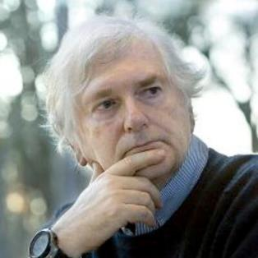
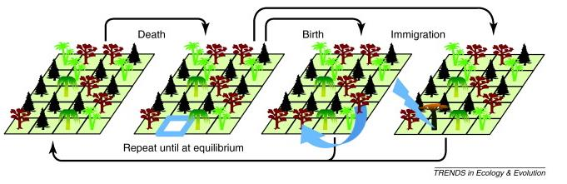
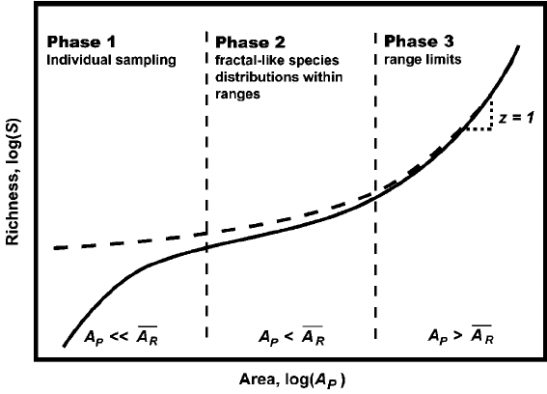
Stephen P. Hubbell – neutral theory of biodiversity
1800
1850
1900
1950
2000
Hubbell (2001) The Unified Neutral Theory of Biodiversity and Biogeography. Princeton.
Notes:
In this panel we can probably all agree that biodiversity is one of the most valuable natural resources.
But things like climate change or habitat loss are a threat to biodiversity, to the extent that we hear about biodiversity crisis, or sixth mass extinction
For example, about 1% of vertebrate species have gone extinct because of humans

Slide 20
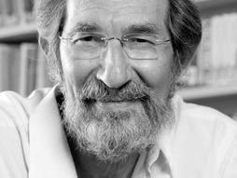
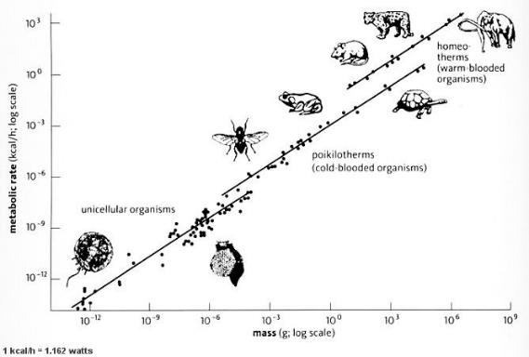
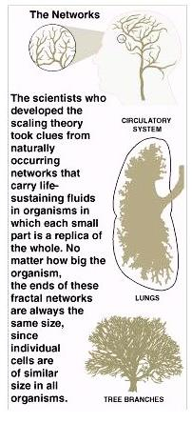
Brown, West, Gillooly, Enquist – metabolic theory of ecology
1800
1850
1900
1950
2000
Fractal networks
Metabolic scaling
Spatial patterns of biodiversity
Brown et al. (2004) Ecology.
Notes:
In this panel we can probably all agree that biodiversity is one of the most valuable natural resources.
But things like climate change or habitat loss are a threat to biodiversity, to the extent that we hear about biodiversity crisis, or sixth mass extinction
For example, about 1% of vertebrate species have gone extinct because of humans

Slide 21
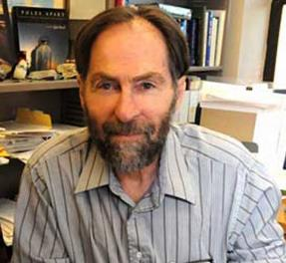
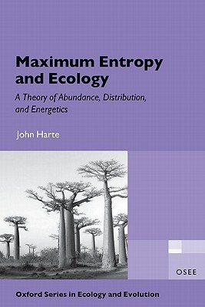
John Harte – maximum entropy theory of ecology
1800
1850
1900
1950
2000
Notes:
In this panel we can probably all agree that biodiversity is one of the most valuable natural resources.
But things like climate change or habitat loss are a threat to biodiversity, to the extent that we hear about biodiversity crisis, or sixth mass extinction
For example, about 1% of vertebrate species have gone extinct because of humans

Slide 22
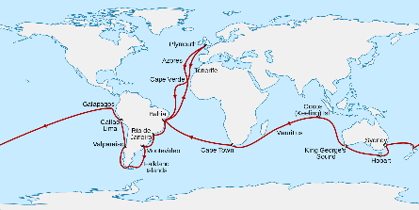
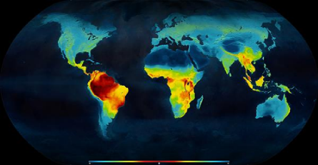
Summary
1800
1850
1900
1950
2000
The age of exploration
Humboldt, Wallace, Darwin
Description of universal
laws and patterns
Arrhenius, Preston, Lawton
The age of theories
Hubbell, Brown, Harte
Log Species diversity
Niche theory
Neutral theory
Metabolic theory
Maximum entropy theory
Log Area
Species-area relationship
Latitudinal gradient of richness
Distance decay of similarity of communities
Species-abundance distributions
Notes:
In this panel we can probably all agree that biodiversity is one of the most valuable natural resources.
But things like climate change or habitat loss are a threat to biodiversity, to the extent that we hear about biodiversity crisis, or sixth mass extinction
For example, about 1% of vertebrate species have gone extinct because of humans

Slide 23
Why should we care? Why does it matter?

Slide 24
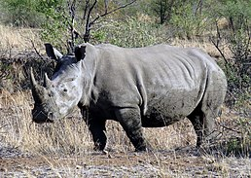
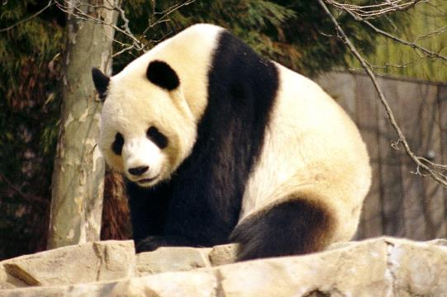
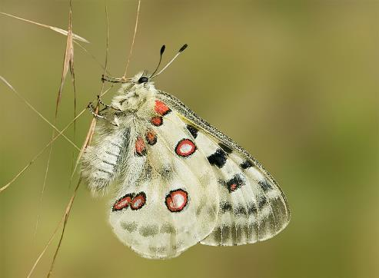
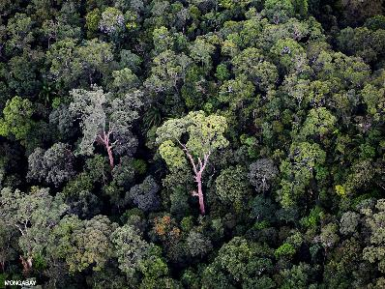
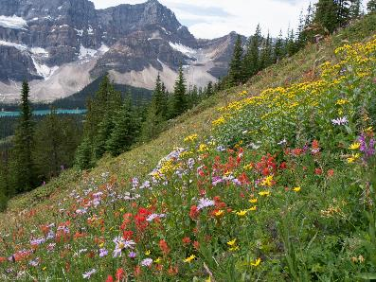
Culture, beauty, emotions, icons – nature’s contributions to people
Diaz et al. (2018) Science
Notes:
In this panel we can probably all agree that biodiversity is one of the most valuable natural resources.
But things like climate change or habitat loss are a threat to biodiversity, to the extent that we hear about biodiversity crisis, or sixth mass extinction
For example, about 1% of vertebrate species have gone extinct because of humans

Slide 25
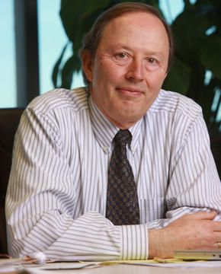
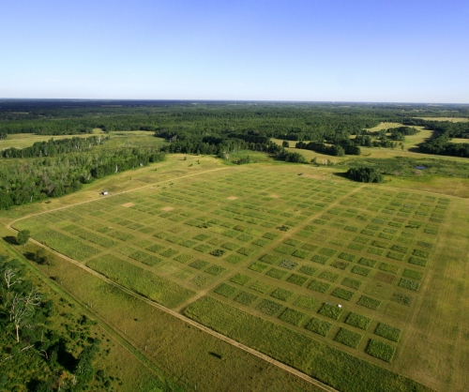
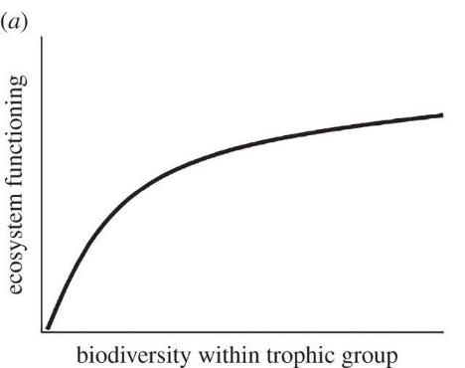
David Tilman – biodiversity and ecosystem functioning
More diverse communities are more productive and stable.
Tilman & Downing (1994) Nature
Notes:
In this panel we can probably all agree that biodiversity is one of the most valuable natural resources.
But things like climate change or habitat loss are a threat to biodiversity, to the extent that we hear about biodiversity crisis, or sixth mass extinction
For example, about 1% of vertebrate species have gone extinct because of humans

Slide 26
The currencies of macroecology

Slide 27
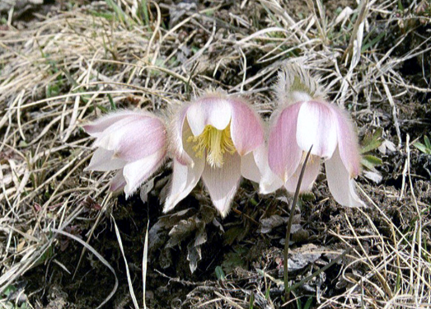
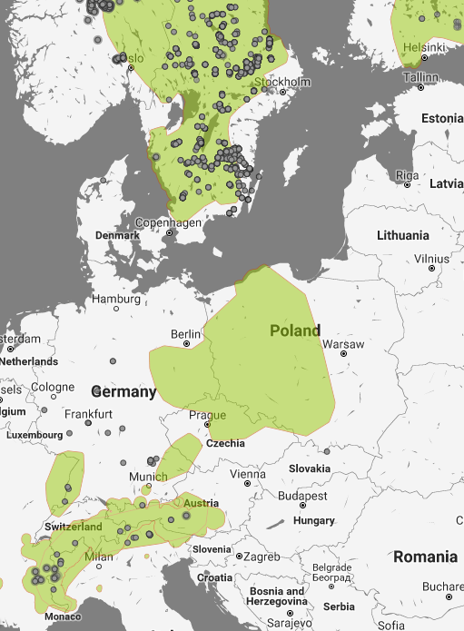
Species geographic distribution
Pulsatilla vernalis
Notes:
In this panel we can probably all agree that biodiversity is one of the most valuable natural resources.
But things like climate change or habitat loss are a threat to biodiversity, to the extent that we hear about biodiversity crisis, or sixth mass extinction
For example, about 1% of vertebrate species have gone extinct because of humans

Slide 28
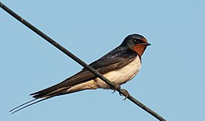
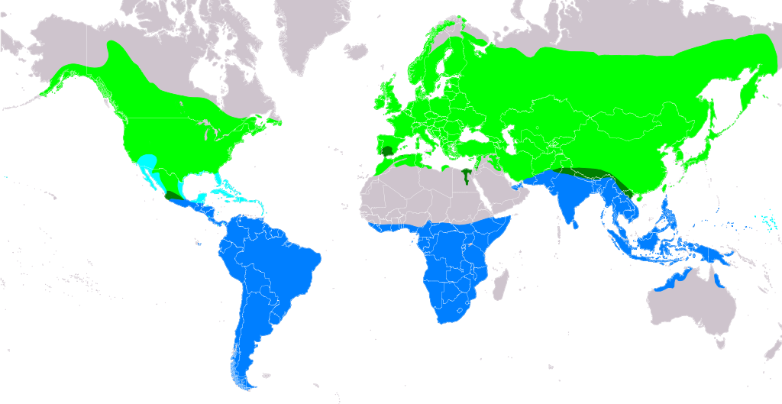
Species geographic range
Hirundo rustica
Source: https://en.m.wikipedia.org/wiki/File:Hirundo_rustica.png
Notes:
In this panel we can probably all agree that biodiversity is one of the most valuable natural resources.
But things like climate change or habitat loss are a threat to biodiversity, to the extent that we hear about biodiversity crisis, or sixth mass extinction
For example, about 1% of vertebrate species have gone extinct because of humans

Slide 29

Species geographic range
Hirundo rustica
Source: eBird (https://science.ebird.org/en/status-and-trends/abundance-animations)
Notes:
In this panel we can probably all agree that biodiversity is one of the most valuable natural resources.
But things like climate change or habitat loss are a threat to biodiversity, to the extent that we hear about biodiversity crisis, or sixth mass extinction
For example, about 1% of vertebrate species have gone extinct because of humans

Slide 30


Species geographic distribution – occupancy or presence/absence
Chroicocephalus ridibundus
Bird atlases of the Czech Republic, Šťastný, Bejček, et al.
Notes:
In this panel we can probably all agree that biodiversity is one of the most valuable natural resources.
But things like climate change or habitat loss are a threat to biodiversity, to the extent that we hear about biodiversity crisis, or sixth mass extinction
For example, about 1% of vertebrate species have gone extinct because of humans

Slide 31
Species abundance, population density
Keil & Hines (2019) Nature Ecology & Evolution
Notes:
In this panel we can probably all agree that biodiversity is one of the most valuable natural resources.
But things like climate change or habitat loss are a threat to biodiversity, to the extent that we hear about biodiversity crisis, or sixth mass extinction
For example, about 1% of vertebrate species have gone extinct because of humans

Slide 32
Commonness and rarity
Deborah Rabinowitz (1981) Seven forms of rarity
Notes:
In this panel we can probably all agree that biodiversity is one of the most valuable natural resources.
But things like climate change or habitat loss are a threat to biodiversity, to the extent that we hear about biodiversity crisis, or sixth mass extinction
For example, about 1% of vertebrate species have gone extinct because of humans

Slide 33
Species diversity, species richness
Keil & Hines (2019) Nature Ecology & Evolution
Notes:
In this panel we can probably all agree that biodiversity is one of the most valuable natural resources.
But things like climate change or habitat loss are a threat to biodiversity, to the extent that we hear about biodiversity crisis, or sixth mass extinction
For example, about 1% of vertebrate species have gone extinct because of humans

Slide 34

Species diversity, species richness
BiodiversityMapping.org
Notes:
In this panel we can probably all agree that biodiversity is one of the most valuable natural resources.
But things like climate change or habitat loss are a threat to biodiversity, to the extent that we hear about biodiversity crisis, or sixth mass extinction
For example, about 1% of vertebrate species have gone extinct because of humans

Slide 35

Species diversity
Czech birds, 1973-2017
PhD student F. Leroy, unpublished analysis
Data from K. Šťastný, V. Bejček, I. Mikuláš, J. Reif
Notes:
In this panel we can probably all agree that biodiversity is one of the most valuable natural resources.
But things like climate change or habitat loss are a threat to biodiversity, to the extent that we hear about biodiversity crisis, or sixth mass extinction
For example, about 1% of vertebrate species have gone extinct because of humans

Slide 36
Species composition
Keil & Hines (2019) Nature Ecology & Evolution
Notes:
In this panel we can probably all agree that biodiversity is one of the most valuable natural resources.
But things like climate change or habitat loss are a threat to biodiversity, to the extent that we hear about biodiversity crisis, or sixth mass extinction
For example, about 1% of vertebrate species have gone extinct because of humans

Slide 37
Example big questions of macroecology

Slide 38
Some big questions (a random selection)
Why are some species rare and others common?
Where are the most biologically rich/poor areas, and why?
What determines species composition?
Why are the tropics so species rich?
How can species coexist?
What are the most important threats to species?
What has been happening with biodiversity in the Anthropocene?
What will the effect of climate change or habitat loss be on biodiversity?
How can we best protect species and biodiversity?
Sutherland et al. (2012) Journal of Ecology
Notes:
In this panel we can probably all agree that biodiversity is one of the most valuable natural resources.
But things like climate change or habitat loss are a threat to biodiversity, to the extent that we hear about biodiversity crisis, or sixth mass extinction
For example, about 1% of vertebrate species have gone extinct because of humans

Slide 39
Thank you. Questions?

